Slide 1

Artificial Intelligence​
Sindh Madrassatul Islam University
Presented By:
Beshair Khan (BIT-24S-006)
Taniya Asif (BIT-24S-014|)
Nuzhat Qureshi (BIT-24S-029|)
…

Slide 2
Hand Gesture Car Moving Game
Introduction
How It Works?
01
04
Objective
Demo
02
05
Technologies Used
03

Slide 3
Introduction of Hand Gesture Car Moving Game
01
…….

Slide 4
Introduction
This project is a hand-gesture-controlled car game made using Python, OpenCV, and MediaPipe. The player controls a car on a moving road using hand movements detected by a webcam. Obstacle cars come from the top, and the player must avoid them. The game includes real-time hand tracking, collision detection, scrolling background, score system, and background music.

Slide 5
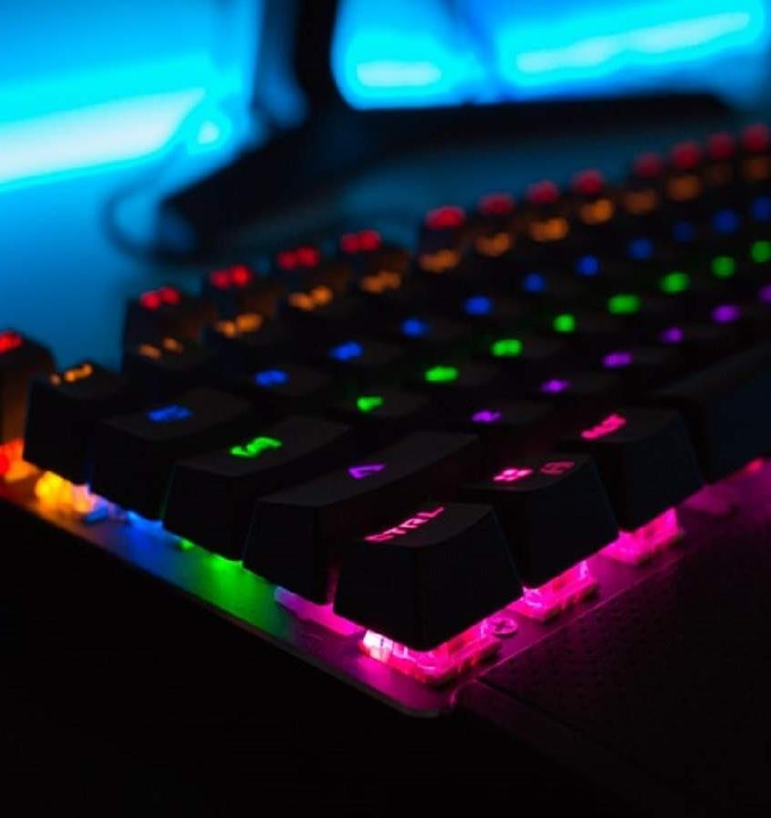
Objective
02
…….

Slide 6
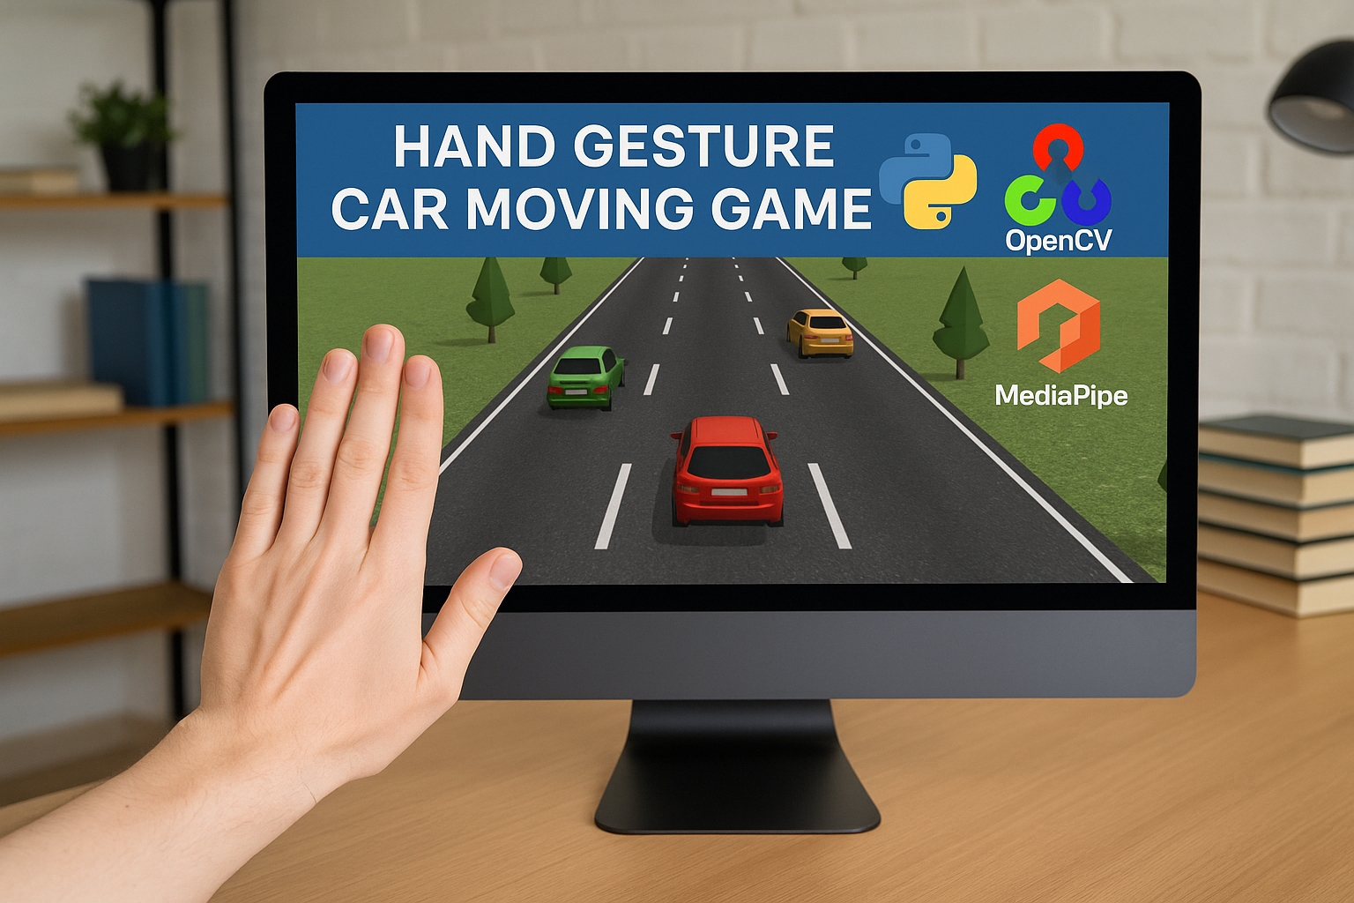
Objective
The main objective of this project is to develop a fun and interactive game that uses hand gestures to control a car, instead of a keyboard or mouse. The goal is to:
Explore computer vision and AI-based hand tracking using MediaPipe
Implement real-time control and collision detection
Enhance game logic with score tracking, speed increase, and background music
This project helps in understanding how AI, image processing, and game development can work together.

Slide 7

Technologies Used
03
….

Slide 8
Technologies Used
Python
MediaPipe
Our main programming language
for hand gesture tracking
OpenCV
Pygame
for video capturing and image processing
for better graphics/audio

Slide 9

How It Works?
04
….

Slide 10
Working
01
02
03
04
Camera captures real-time video.
MediaPipe detects the hand and its landmarks.
Game detects hand position (e.g., left, right).
Car moves according to hand gesture.

Slide 11
Working of Program
04
…..

Slide 12
Hand Detection:
mp_hands = mp.solutions.hands
hands = mp_hands.Hands(max_num_hands=1)
Explanation: Used MediaPipe to detect hand and get landmarks for wrist and palm.
Car Control Using hand Gesture:
if wrist_x < frame_width // 3:
car_x -= car_speed
elif wrist_x > 2 * frame_width // 3:
car_x += car_speed
Explanation:
Move car left or right based on wrist x-position.
Car only moves if palm is above wrist (hand raised).

Slide 13
Scrolling Road and Obstacles:
scroll_y = (scroll_y + obstacle_speed) % frame_height
obstacles.append([random_x, -car_height])
Explanation: Background road image scrolls to create movement
Obstacle car spwan from top and move down
Collision Hits and Game Over:
if car hits obstacle:
game_over = True
Explanation: If player car and obstacle overlap → game over.
Shows “GAME OVER” and lets user press R to restart.

Slide 14
Background Music:
pygame.mixer.music.load("background_music.mp3")
pygame.mixer.music.play(-1)
Explanation: Music plays in the background using pygame.

Slide 15
Important Functions of Program
05
…..

Slide 16
overlay_image(bg, fg, x, y)
Purpose:
To overlay (paste) the car or obstacle image with transparency (alpha channel) on top of the game background.
reset_game()
Purpose:
To restart the game after Game Over — resets all variables.

Slide 17
main game loop (while True:)
Purpose:
The heart of the game that runs continuously:
Captures webcam input
Detects hand and controls car
Scrolls background
Spawns and moves obstacles
Checks for collisions
Updates score and speed
Handles Game Over and restart

Slide 18
Hand Gesture Detection
Library Used: MediaPipe
Purpose: Detects hand and gets wrist position to control the car's left-right movement.
results = hands.process(img_rgb)
if wrist_x < frame_width // 3:
car_x -= car_speed
elif wrist_x > 2 * frame_width // 3:
car_x += car_speed

Slide 19
Obstacle Spawning & Movement
Purpose: Spawns enemy cars from the top and moves them downward
if frame_count % obstacle_spawn_delay == 0:
obstacles.append([random_x, -obstacle_car_height])
Collision Detection
Purpose: Ends the game if player car hits an obstacle.
if obstacle overlaps with player car:
game_over = True

Slide 20
Important Functions Summary
Function Name | Purpose
overlay_image() | Adds car and obstacle images (with transparency) on the game background.
reset_game() | Resets all game variables to start a new game after Game Over.
main game loop | Runs the whole game: reads camera, updates car, obstacles, and display.
Hand Gesture Control | Detects hand using MediaPipe; moves car left/right based on wrist.
Obstacle Management | Spawns enemy cars and moves them downward on the screen.
Collision Detection | Checks if player's car hits any obstacle; triggers Game Over.

Slide 21
Demo
06
…..

Slide 22
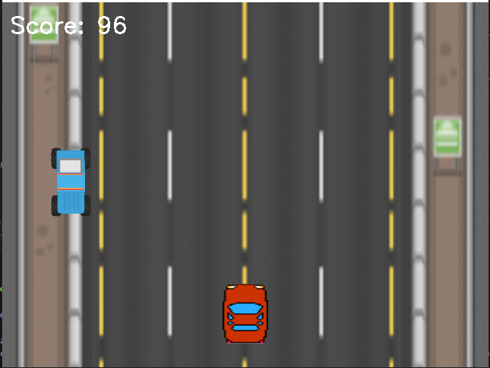
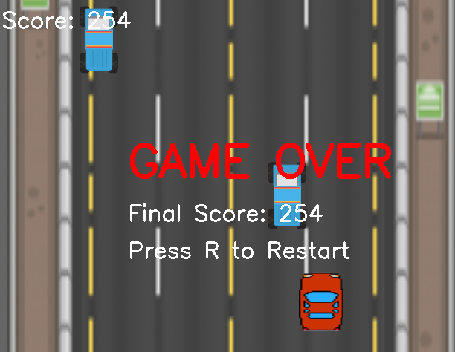
Game

Slide 23
Thank You!

